Slide 2
MODULE -4 PREPARATION OF PROJECT AND ERP
By,
Prof. Muneshwara M S
Dept. of CSE, BMSIT&M, Yelahanka,
Bengaluru-560064

Slide 3
Contents
Preparation of project
Meaning of project.
Project identification.
Project Selection.
Project report.
Need and significance of project report. contents.
Formulation.
Guidelines by planning commission for project report.

Slide 4
Contents(contd..)
Enterprise Resource Planning:
Meaning of ERP
Importance of ERP
Functional areas of Management
Marketing / Sales
Supply Chain Management
Finance & Accounting
Human Resources
Types of Reports
Methods of Report Generation

Slide 5
MEANING OF PROJECT
An entrepreneur takes numerous decisions to convert his business idea into a running concern.
His/Her decision making process starts with project/product selection.
The project selection is the first corner stone to be laid down in setting up an enterprise.
The success or failure of an enterprise largely depends upon the project.
The popular English proverb ―well began is half done , applies to project selection also indicates the significant of good beginning.

Slide 6
MEANING OF PROJECT(Contd..)
The dictionary meaning of project is that is a scheme, design a proposal of something intended or devised to be achieved.
Newman and his associates define that ―a project has typically has a distinct mission that it is designed to achieve and clear termination point, the achievement of the mission.
Gillinger defines project ―as a whole complex of activities involved in using resources to gain benefits.

Slide 7
MEANING OF PROJECT(Contd..)
According to Encyclopedia of management, ―a project is an organized unit dedicated to the attainment of goal—the successful completion of a development project on time, within budget, in conformance with predetermined programme specifications.
Now, a project can be defined as a scientifically evolved work plan devised to achieve a specific objective within a specified period of time.
Project can differ in their size, nature of objectives, time duration and complexity.

Slide 8
MEANING OF PROJECT(Contd..)
However projects partake of the following three basic attributes:
(i) A course of action
(ii) Specific objectives and
(iii) Definite time perspectives.
Every project has starting point, an end point with specific objectives.

Slide 9
PROJECT CLASSIFICATION
Project classification helps in expressing and highlighting the essential features of project.
Different authorities have classified projects differently.
The following are some of the important classification of projects.
Quantifiable and Non-Quantifiable Projects
Quantifiable projects are those in which possible quantitative assessment of benefits can be made.

Slide 10
PROJECT CLASSIFICATION(Contd..)
Non-quantifiable projects are those where such assessment is not possible.
Projects concerned with industrial development, power generation, mineral development fall in the first category
While projects involving health, education and defence fall in the second category.

Slide 11
PROJECT CLASSIFICATION(Contd..)
(2).Sectional Projects Here the classification is
based on various sectors like
● Agriculture and allied sector
● Irrigation and power sector
● Industry and mining sector
● Transport and communication sector
● Information technology sector
● Miscellaneous
This system of classification has been found useful in resource allocation at macro level.

Slide 12
PROJECT CLASSIFICATION(Contd..)
(3).Techno-Economic Projects
Classification of projects based on
techno-economic characteristic fall
in this category.
This type of classification includes
a). Factors intensity-oriented classification,
b).Causation oriented classification.
c). Magnitude-oriented classification
as discussed below.

Slide 13
PROJECT CLASSIFICATION(Contd..)
a). Factor intensity-oriented classification:
Based on this projects may be classified as capital intensive or labor intensive.
If large investment is made in plant and machinery the project will be termed as capital intensive.
On the other hand project involving large number of human resources will be termed as ―labor intensive.

Slide 14
PROJECT CLASSIFICATION(Contd..)
(b) Causation-oriented classification:
On the basis of causation, projects can be classified as demand based and raw material based projects.
The availability of certain raw materials, skills or other inputs makes the project raw-material based and the very existence of demand for certain goods or services make the project demand-based.

Slide 15
PROJECT CLASSIFICATION(Contd..)
(c) Magnitude-oriented classification:
This is based on the size of investment involved in the projects, accordingly project are classified into large scale, medium-scale or small-scale projects.
The selection of a project consists of two main steps:
S1: Project identification
S2: Project selection.

Slide 16
PROJECT IDENTIFICATION
Often indenting entrepreneurs always are in search of project having a good market but how without knowing the product coat they determine market whose market they find out without knowing the item i.e. product?
Idea generation about a few projects provides a way to come out of the above tangle.

Slide 17
PROJECT IDENTIFICATION (contd..)
IDEA GENERATION
The process of project selection starts with idea generation.
In order to select most promising and profitable project, the entrepreneur has to generate large number of ideas about the possible projects he can take.
The project ideas can be discovered from various internal and external sources.

Slide 18
PROJECT IDENTIFICATION (contd..)
These may include:
Knowledge of potential customer needs.
Personal observation of emerging trends in demand for certain products.
Scope for producing substitute product.
Trade and professional magazines which provide a very fertile source of project ideas.
Departmental publications of various departments of the government.
Success stories of known entrepreneurs or friends or relatives.
A new product introduced by the competitor.
Ideas given by knowledgeable persons.

Slide 19
PROJECT IDENTIFICATION (contd..)
All these sources putting together may give few ideas about the possible projects to be examined among which the project must be selected.
After going through these sources if an entrepreneur has been able to get six project ideas, one project idea will be finally selected going through the following selection process.

Slide 20
PROJECT SELECTION
Project selection starts once the entrepreneur has generated few ideas of project.
After having some ideas, these project ideas are analyzed in the light of existing economic conditions, market conditions, and the government policy and so on.
For this purpose a tool is generated used what is called SWOT(Strengths, Weaknesses, Opportunities, and Threats) analysis.

Slide 21
PROJECT SELECTION (contd..)
The intending entrepreneur analyses his strengths and weaknesses as well as opportunities/competitive advantages and threats/challenges offered by each of the project ideas.
In addition the entrepreneur needs to analyze other related aspects also like raw material, potential market, labor, capital, location and forms of ownerships etc.

Slide 22
PROJECT SELECTION (contd..)

Slide 23
PROJECT SELECTION (contd..)
Each of these aspects has to be evaluated independently and in relation to each of these aspects.
This forms a continuous and back and forth process as shown in Fig 8.1.
On the basis of this analysis, the most suitable idea is finally selected to convert it into an enterprise.
The process involved in selecting a project out of few projects is also termed as ―Zeroing in Process‖.

Slide 24
PROJECT SELECTION (contd..)
Interdependent aspects of projects Readers are advised to note that there is a time interval involved in between project identification and project selection.
In some cases it may be few months and in others it may be few minutes.

Slide 25
PROJECT REPORT
Webster new 20th century dictionary defines as a scheme, design a proposal something intended or devised.
A project report or a business plan is a written statement of what an entrepreneur proposes to take up.
It is a kind of guide frost or course at action what the entrepreneur hopes to achieve in his business and how is he going to achieve it

Slide 26
Need and great significance of project report is for an entrepreneur.
A project report serves like a kind of big road map to reach the destination determined by entrepreneur.
Hence a project report can be defined as a well evolved course of action devised to achieve the specified objectives within a specified period of time.
It is like an operating document.
The preparation of project report is of great significance for an entrepreneur.

Slide 27
The project report serves two essential purposes.
1. The first essential purpose
The project report is like a road map it describes the direction the enterprise is going in, what its goals are, where it wants to be, and how it is going to get there.
In addition it enables the entrepreneur to know that he is proceeding in the right direction.
Dan Steinhoff and John F. Burgess hold the view that without well spelled out goals and operational methods, most businesses flounder on the rocks of hard times.

Slide 28
2. The Second essential purpose
The project report is to attract lenders and investors.
The preparation of project report is beneficial for those small scale enterprises which apply for financial assistance from the financial institutions and commercial banks.
On the basis of this project report the financial institutes make appraisal and decide whether financial assistance should be given or not
If yes how much. Other organizations which provide various assistance like work shed/land, raw material etc, also make decision on the basis of this project report

Slide 29
CONTENTS OF A PROJECT REPORT
The more concrete and complete project report not only serves as road map but also earns the respect of outsiders who support in making and running an enterprise.
Hence project report should be prepared with great care and consideration.
A good project report should contain the following.
(1)General information: Information on product profile and product details.

Slide 30
(2) Promoter: His/her educational qualification, work experience, project related experience.
(3) Location: exact location of the project, lease or freehold, location advantages.
(4) Land and building: land area, construction area, type of construction, cost of construction, detailed plan and estimate along with plant layout.
(5) Plant and machinery: Details of machinery required, capacity, suppliers, cost, various alternatives available, cost of miscellaneous assets.
(6) Production process: Description of production process, process chart, technical know how, technology alternatives available, production programme.
(7) Utilities: Water, power, steam, compressed air requirements, cost estimates sources of utilities.
(8) Transport and communication: Mode, possibility of getting costs

Slide 31
(9) Raw material: List of raw material required by quality and quantity, sources of procurement, cost of raw material, tie-up arrangements, if any for procurement of raw material, alternative raw material, if any.
(10) Man power: Man power requirement by skilled and semi-skilled, sources of manpower supply, cost of procurement, requirement for training and its cost.
(11) Products: Product mix, estimated sales distribution channels, competitions and their capacities, product standard, input-output ratio, product substitute.

Slide 32
(12) Market: End-users of product, distribution of market as local, national, international, trade practices, sales promotion devices, proposed market research. (13) Requirement of working capital: Working capital required, sources of working capital, need for collateral security, nature and extent of credit facilities offered and available.
(14) Requirement of funds: Break-up project cost in terms of costs of land, building machinery, miscellaneous assets, preliminary expenses, contingencies and margin money for working capital, arrangements for meeting the cost of setting up of the project.
(15) Cost of production and profitability of first ten years.
(16) Break-even analysis.
(17) Schedule of implementation.

Slide 33
FORMULATION OF PROJECT REPORT
A project report is like a road map.
It is an operating document.
What information and how much information it contain depends upon the size of the enterprise, as well as nature of production.
For example small-scale enterprises do not include technology which is used for preparing project reports of large-scale enterprises.
Within small-scale enterprises too, all information may not be homogeneous for all units.

Slide 34
Vinod Gupta has given a general set of information in his study ―Formation of a project report.
According to Gupta, project formulation divides the process of project development into eight distinct and sequential stages as below:
(1) General information
(2) Project description
(3) Market potential
(4) Capital costs and sources of finance
(5)Assessment of working capital requirements
(6) Other financial aspects
(7) Economical and social variables
(8) Project implementation

Slide 35
The nature of formation to be collected and furnished under each of these stages has been given below.
(1) General Information:
The information of general nature given in the project report includes the following:
Bio-data of promoter:
Name and address, qualifications, experience and other capabilities of the entrepreneur.
Similar information of each partner if any.
Industry profile:
A reference analysis of industry to which the project belongs, e.g., past performance; present status, its organization, its problems etc.

Slide 36
Constitution and organization:
The constitution and organization structure of the enterprise; in case of partnership firm its registration with registrar of firms, certification from the directorate of industries/district industry centre.
Product details: Product utility, product range, product design, advantage to be offered by the product over its substitutes if any.

Slide 37
(2) Project Description
A brief description of the project covering the following aspects should be made in the project report.
Site: Location of the unit; owned, rented or leasehold land; industrial area; no objection certificate from municipal authorities if the enterprise location falls in the residential area.
Physical Infrastructure: Availability of the following items of infrastructure should be mentioned in the project report.

Slide 38
Raw material:
Requirement of raw material, whether inland or imported, sources of raw material supply.
(b) Skilled labour:
Availability of skilled labour in the area i.e., arrangements for training labourers in various skills.
(c) Utilities:
These include:
Power: Requirement of power, load sanctioned, availability of power
Fuel: Requirement of fuel items such as coal, coke, oil or gas, state of their availability and supply position.
Water: The sources of water, quality and quantity available.

Slide 39
(d) Pollution control:
The aspects like scope of dumps, sewage system, sewage treatment plant, infiltration facility etc., should be mentioned.
(e) Communication and transportation facility:
The availability of communication facilities,
e.g., telephone, fax, telex, internet etc., should be indicated.
Requirements for transport, mode of transport, potential means of transport, approximate distance to be covered, bottlenecks etc., should be stated in the business plan.

Slide 40
(f) Production process:
A mention should be made for process involved in production and period of conversion from raw material into finished goods.
(g) Machinery and equipment:
A complete list of machines and equipment required indicating their size, type, cost and sources of their supply should be enclosed with the project report.
(h) Capacity of the plant:
The installed licensed capacity of the plant along with the shifts should also be mentioned in the project report.

Slide 41
(i) Technology selected:
The selection of technology, arrangements made for acquiring it should be mentioned in the business plan.
(j) Other common facilities:
Availability of common facilities like machine shops, welding shops and electrical repair shops etc should be stated in the project report.
(k) Research and development:
A mention should be made in the project report regarding proposed research and development activities to be undertaken in future.

Slide 42
(3) Market Potential:
While preparing a project report, the following aspects relating to market potential of the product of the product should be stated in the report.
Demand and supply position: State the total expected demand for the product and present supply position, what is the gap between demand and supply and how much gap will fill up by the proposed unit.
Expected price: Expected price of the product to be realized should also be mentioned.
Marketing strategy: Arrangements made for selling the product should be clearly stated in the project report.
After sales service: Depending upon the nature of the product, provisions made for after-sales should normally be stated in the project report.

Slide 43
(4) Capital Costs and Sources of Finance:
An estimate of the various components of capital items like land and buildings, plant and machinery, installation costs, preliminary expenses, margin of working capital should be given in the project report.
The sources should indicate the owners funds together with funds raised from financial institutions and banks.

Slide 44
(5) Assessment of Working Capital:
The requirement for working capital and its sources of supply should clearly be mentioned.
It is preferred to prepare working capital requirements in the prescribed formats designed by limits of requirement.
It will reduce the objections from banker‘s side.

Slide 45
(6) Other Financial Aspects
To adjudge the profitability of the project to be set up, a projected profit and loss account indicating likely sales revenue, cost of production, allied cost and profit should be prepared.
A projected balance sheet and cash flow statement should also be prepared to indicate the financial position and requirements at various stages of the project.
In addition to this, the break even analysis should also be presented.
Break even point is the level of production at which the enterprise shall earn neither profit nor incur loss.

Slide 46
Breakdown level indicates the gestation period and the likely moratorium required for repayment of the loans.
Break-even point is calculated as Break-Even Point (BEP) = F/S–V
Where F = Fixed Cost
S = Selling Price/Unit
V = Variable Cost/Unit
The break-even point indicates at what level of output the enterprise will break even.

Slide 47
(7) Economical and Social Variables:
Every enterprise has social responsibility.
In view of the social responsibility of business, the abatement costs, i.e., the costs for controlling the environmental damage should be stated in the project.
Arrangements made for treating the effluents and emissions should also be mentioned in the report.
In addition the following socio-economic benefits should also be stated in the report.
(i) Employment Generation
(ii) Import Substitution
(iii) Ancillaration
(iv) Exports
(v) Local Resource Utilization
(vi) Development of the Area

Slide 48
(8) Project Implementation:
Every entrepreneur should draw an implementation scheme or a time-table for his project to the timely completion of all activities involved in setting up an enterprise.
If there is delay in implementation project cost overrun.
Delay in project implementation jeopardizes the financial viability of the project, on one hand, and props up the entrepreneur to drop the idea to set up an enterprise, on the other.
Hence there is need to draw up an implementation schedule for the project and then to adhere to it.
PERT and CPM discussed later in this chapter can be used to get better insight into all activities related to implementation of the project.

Slide 49
GUIDELINES BY PLANNING COMMISSION FOR PROJECT REPORT
Planning commission of India issued some guide lines for preparing/ formulating realistic project reports.
The project formulation stage involves the identification of investment options by the enterprise and in consultation with the Administrative ministry the planning commission and other concerned authorities.
The summary of the guidelines by planning commission are presented here

Slide 50
General information:
The feasibility report should include an analysis of the industry to which the project belongs.
It should deal with the past performance of the industry.
The description of the type of industry should also be given, i.e., the priority of the industry, increase in production, role of the public sector, allocation of investment of funds, choice of technique, etc.
This should contain information about the enterprise submitting the feasibility report

Slide 51
2. Preliminary analysis of alternatives:
This should contain present data on the gap between demand and supply for the outputs which are to be produced,
Data on the capacity that would be available from projects that are in production or under implementation at the time the report is prepared,
A complete list of all existing plants in the industry, giving their capacity and their level of production actually attained, a list of all projects for which letters of intent licenses have been issued and a list of proposed projects.
All options that are technically feasible should be considered at this preliminary stage.

Slide 52
The location of the project and its implications should also be looked into.
An account of the foreign exchange requirement should be taken.
The profitability of different options should also be looked into.
An account of the foreign exchange requirement should be taken.
The profitability of different options shou1d also be given.
The rate of return on investment should be calculated and presented in the report.
Alternative cost calculations vis-à-vis return should be presented.

Slide 53
3.Project description:
The feasibility report should provide a brief description of the technology/process chosen for the project.
Information relevant for determining the optimality of the location chosen should also be included.
To assist in the assessment of the environmental effects of a project every feasibility report must present the information on specific points, i.e., population, water, land, air, flora, fauna, effects arising out of the project‘s pollution, other environmental destruction, etc.
The report should contain a list of important items of capital equipment and also the list of the operational requirements of the plant, requirements of water and power, requirements of personnel, organizational structure envisaged, transport costs, activity wise phasing of construction and factors affecting it.

Slide 54
4. Marketing plan:
It should contain the following items:
Data on the marketing plan, demand and prospective supply in each of the areas to be served.
The methods and the data used for making estimates of domestic supply and selection of the market areas should be presented.
Estimates of the degree of price sensitivity should be presented. It should contain an analysis of past trends in prices.

Slide 55
5. Capital requirements and cost:
The estimates should be reasonably complete and properly estimated. Information on all items of costs should be carefully collected and presented.
6. Operating requirements and costs:
Operating costs are essentially those costs which are incurred after the commencement of commercial production.
Information about all items of operating cost should be collected.
Operating costs relate to cost of raw, materials and intermediaries, fuel, utilities, labour, repair and maintenance, selling expenses and other expenses.

Slide 56
7. Financial analysis:
The purpose of this analysis is to present some measures to asses the financial viability of the project.
A Performa balance sheet for the project data should be presented.
Depreciation should be allowed for on the basis specified by the Bureau of Public Enterprises.
Foreign exchange requirements should be cleared by the Department of Economic Affairs.
The feasibility report should take into account income tax rebates for priority industries, incentives for backward areas, accelerated depreciation, etc.
The sensitivity analysis should also be presented.
The report must analyze the sensitivity of the rate of return on the level and pattern of product prices.

Slide 57
8. Economic analysis:
Social profitability analysis needs some adjustments in the data relating to the costs and return to the enterprise.
One important type of adjustment involves a correction in input and cost, to reflect the true value of foreign exchange, labour and capital.
The enterprise should try to assess the impact of its operations on foreign, trade.
Indirect costs and benefits should also be included in the report. If they cannot be quantified they should be analyzed and their importance emphasized.

Slide 58
END of Preparation of Project

Slide 59
CONTENTS
Enterprise Resource Planning: Meaning & Importance
Functional areas of Management
Marketing / Sales
Supply Chain Management
Finance & Accounting
Human Resources
Types of Reports
Methods of Report Generation
2

Slide 60
Enterprise Resource Planning
Enterprise resource planning system is a fully integrated business management system covering functional areas of an enterprise like Logistics, Production, Finance, Accounting and Human Resources. It organizes and integrates operation processes and information flows to make optimum use of resources such as men, material, money and machine.
Enterprise resource planning promises one database, one application, one user interface

Slide 61
Enterprise Resource Planning
ERP delivers a single database that contains all data for the software modules, which would include:
Manufacturing: Engineering, bills of material, scheduling, capacity, workflow management, quality control, cost management, manufacturing process, manufacturing projects, manufacturing flow.
Supply chain management :Order to cash, inventory, order entry, purchasing,product configuration, supply chain planning, supplier scheduling, and inspection of goods, claim processing, and commission calculation.
Financials: General ledger, cash management, accounts payable, accounts receivable, fixed assets.

Slide 62
Enterprise Resource Planning
Project management: Costing, billing, time and expense, performance units, activity management.
Human resources: Human resources, payroll, training, time and attendance, roistering, benefits.
Customer relationship management: Sales and marketing, commissions, service, customer contact and call center support, Data warehouse and various self-service interfaces for customers, suppliers, and employees.
Access control : user privilege as per authority levels for process execution Customization - to meet the extension, addition, change in process flow.

Slide 63
ERP Characteristics
Flexibility : An ERP system should be flexible to respond to the changing needs of an enterprise.
Modular & Open : ERP system has to have open system architecture.
Comprehensive : It should be able to support variety of organizational functions
Beyond The Company : It should not be confined to the organizational boundaries.
Best Business Practices : It must have a collection of the best business processes applicable worldwide.

Slide 64
Features of ERP
ERP provides multi-platform, multi-facility, multi-mode manufacturing, multi-currency, multi-lingual facilities.
It supports strategic and business planning activities, operational planning and execution activities, creation of Materials and Resources.
ERP covering all functional areas like manufacturing, selling and distribution, payables, receivables, inventory, accounts, human resources, purchases etc.
ERP performs core activities and increases customer service, thereby augmenting the corporate image.
ERP bridges the information gap across organizations.
ERP is the solution for better project management.

Slide 65
Features of ERP
ERP provides complete integration of systems not only across departments but also across companies under the same management.
ERP allows automatic introduction of the latest technologies like Electronic Fund Transfer (EFT), Electronic Data Interchange (EDI), Internet, Intranet, Video conferencing, E-Commerce etc.
ERP eliminates most business problems like material shortages, productivity enhancements, customer service, cash management, inventory problems, quality problems, prompt delivery etc.
ERP provides intelligent business tools like decision support system, Executive information system, Data mining and easy working systems to enable better decisions.

Slide 66
Benefits of ERP
Gives Accounts Payable personnel increased control of invoicing and payment processing and thereby boosting their productivity and eliminating their reliance on computer personnel for these operations.
Reduce paper documents by providing on-line formats for quickly entering and retrieving information.
Improves timeliness of information by permitting posting daily instead of monthly.
Greater accuracy of information with detailed content, better presentation, satisfactory for the auditors.

Slide 67
Benefits of ERP
Improved cost control.
Faster response and follow-.up on customers.
More efficient cash collection, say, material reduction in delay in payments by customers.
Better monitoring and quicker resolution of queries.
Enables quick response to change in business operations and market conditions.
Helps to achieve competitive advantage by improving its business process.

Slide 68
Benefits of ERP
Improves supply-demand linkage with remote locations and branches in different countries.
Provides a unified customer database usable by all applications.
Improves International operations by supporting a variety of tax structures, invoicing schemes, multiple currencies, multiple period accounting and languages.
Improves information access & management throughout the enterprise.

Slide 69
Functional Areas of Operation
Marketing and Sales (M/S)
Supply Chain Management (SCM)
Accounting and Finance (A/F)
Human Resources (HR)
Business functions: Activities specific to a functional area of operation

Slide 70
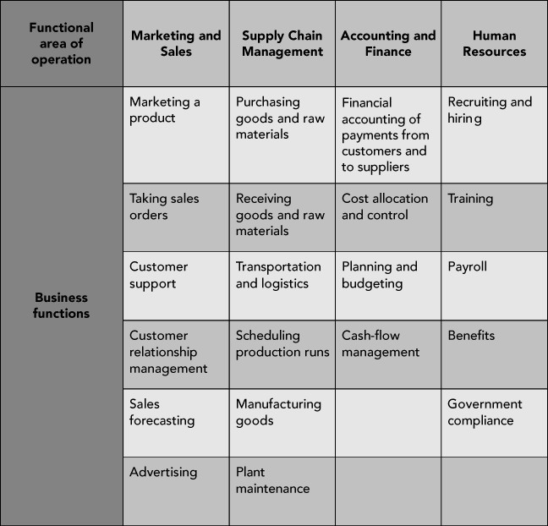
Functional Areas of Operation (cont’d.)
Examples of functional areas of operation and their business functions

Slide 71
Functional Areas of Operation (cont’d.)
Functional areas are interdependent
– Each requires data from the others
Better integration of functional areas leads to improvements in communication, workflow, and success of company
Information system (IS): Computers, people, procedures, and software that store, organize, and deliver information

Slide 72
Business Processes
Collection of activities that takes one or more kinds of input and creates an output that is of value to customer
– Customer can be traditional external customer or internal customer
Thinking in terms of business processes helps managers to look at their organization from the customer’s perspective

Slide 73
Functional Areas and Business Processes of a Very Small Business
Example: A fictitious coffee shop
Examine business processes of the coffee shop
See why coordination of functional areas helps achieve efficient and effective business processes
Look at how integration of the information system improves the business
36

Slide 74
Marketing and Sales
Functions of Marketing and Sales
Developing products
Determining pricing
Promoting products to customers
Taking customers’ orders
Helping create a sales forecast

Slide 75
Marketing and Sales (cont’d.)
Marketing and Sales tasks for the coffee shop
Formal recordkeeping not required
Need to keep track of customers
Product development can be done informally
Good repeat customers allowed to charge purchases—up to a point
Records must show how much each customer owes and his or her available credit

Slide 76
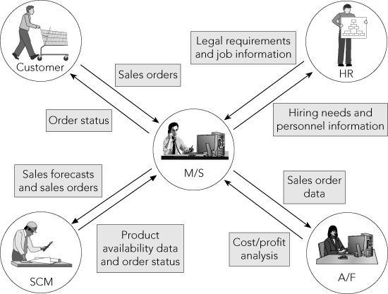
Marketing and Sales (cont’d.)
The Marketing and Sales functional area exchanges data with customers and with the Human Resources, Accounting and Finance, and Supply Chain Management functional areas

Slide 77
Supply Chain Management
Supply chain management (SCM) is the active management of supply chain activities to maximize customer value and achieve a sustainable competitive advantage.
It represents a conscious effort by the supply chain firms to develop and run supply chains in the most effective & efficient ways possible.
Supply chain activities cover everything from product development, sourcing, production, and logistics, as well as the information systems needed to coordinate these activities.

Slide 78
Supply Chain Management
Needs information from various functional areas
Production plans based on information about product sales (actual and projected) that comes from Marketing and Sales
With accurate data about required production levels:
Raw material and packaging can be ordered as needed
Inventory levels can be kept low, saving money

Slide 79
Supply Chain Management
Functions within Supply Chain Management
Making the coffee (manufacturing/production)
Buying raw materials (purchasing)
Production planning requires sales forecasts from M/S functional area
Sales forecasts: Analyses that attempt to predict the future sales of a product

Slide 80
Supply Chain Management (cont’d.)
Production plans used to develop requirements for raw materials and packaging
Raw materials: Bottled spring water, fresh lemons, artificial sweetener, raw sugar
Packaging: Cups, straws, napkins
SCM and M/S must choose a recipe for each coffee product sold

Slide 81
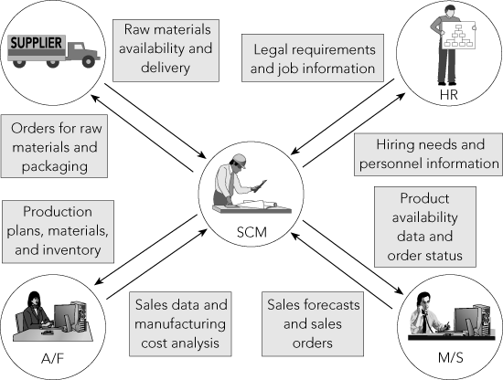
Supply Chain Management (cont’d.)
The Supply Chain Management functional area exchanges data with suppliers and with the Human Resources, Marketing and Sales, and Accounting and Finance functional areas

Slide 82
Accounting and Finance
Functions within Accounting and Finance
– Recording raw data about transactions (including sales), raw material purchases, payroll, and receipt of cash from customers
Raw data: Numbers collected from sales, manufacturing and other operations, without any manipulation, calculation, or arrangement for presentation

Slide 83
Accounting and Finance (cont’d.)
Data from Accounting and Finance used by Marketing and Sales and Supply Chain Management
Sales records are important component of sales forecast
Sales forecast is used in making staffing decisions and in production planning
Records from accounts receivable used to monitor the overall credit-granting policy of the coffee shop

Slide 84
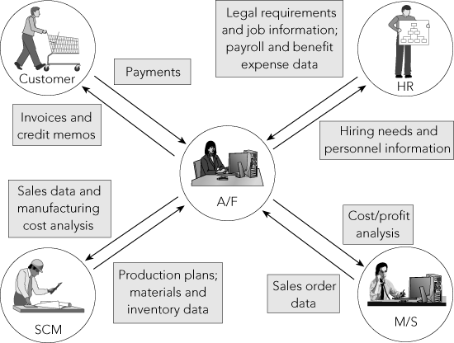
Accounting and Finance (cont’d.)
The Accounting and Finance functional area exchanges data with customers and with the Human Resources, Marketing and Sales, and Supply Chain Management functional areas

Slide 85
Human Resources
Functions of Human Resources
– Recruit, train, evaluate, and compensate employees
HR uses sales forecasts developed by the individual departments to plan personnel needs
Systems integrated using ERP software provide the data sharing necessary between functional areas

Slide 86
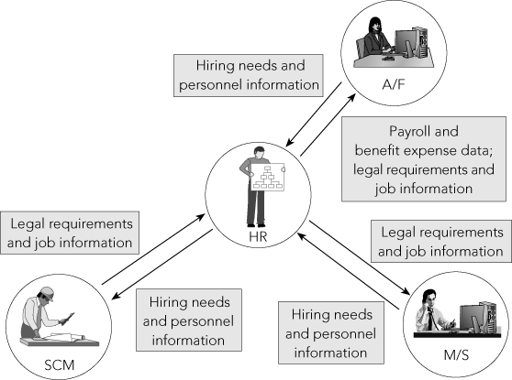
Human Resources (cont’d.)
The Human Resources functional area exchanges data with the Accounting and Finance, Marketing and Sales, and Supply Chain Management functional areas

Slide 87
Network Analysis
A network diagram represents the various activities of a project.
An event/node marks the begin/end of an activity.
An activity is represented by a straight line arrow.
There can be only one activity between 2 nodes.
A dummy activity is a hypothetical activity which does not require any type of resource. And duration is 0.

Slide 88
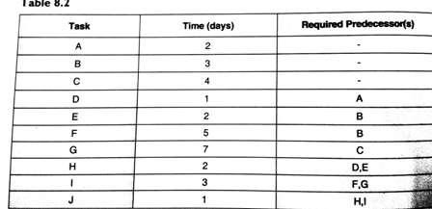
Critical Path Method

Slide 89

Critical Path Method

Slide 90
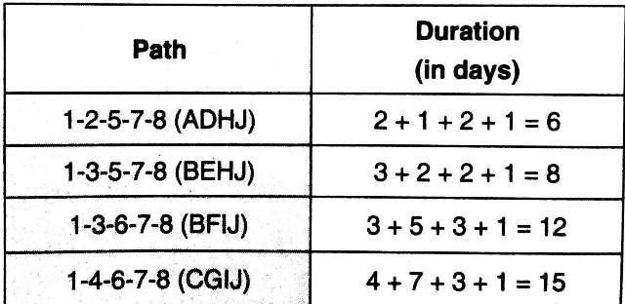
Critical Path Method

Slide 91
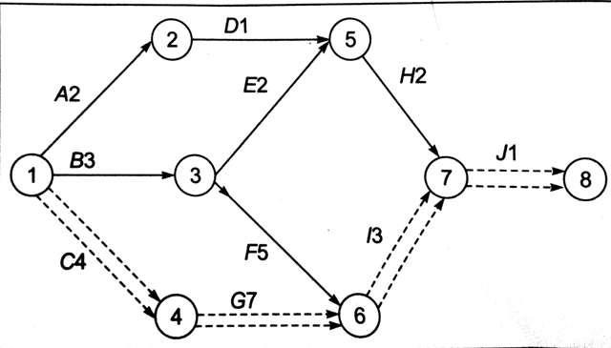
Critical Path Method

Slide 92
PERT: Programme Evaluation & Review Technique
PERT is applied in projects where the duration of various activities cannot be predicted with certainty.
Similar to CPM.
Suitable for R&D projects.

Slide 93
PERT: Programme Evaluation & Review Technique
PERT calculates 3 time estimates for each activity based on their past activity.
Optimistic time estimate t_{o} : shortest time estimates
Pessimistic time estimates t_{p} : longest time estimates
Most likely time estimate t_{m}: highest probability of occurrence.
Mean time(t_{e}) = (t_{o} + 4t_{m} + t_{p})/6

Slide 94
Types of Project Report
Status Report
Risk Report
Board/ Executive Report
Resource Report

